Slide 1
CROP PRODUCTION IN INDIA
- DINESH K K V (71762133012)
Subramanian s (71762133044)

Slide 2
Objectives:
This dashboard helps us to know the difference between the cost of production, cost of cultivation and yield of the crops per hectare or quintal.
To provide the information on the cost of production and cultivation of different type of crops in the respective states

Slide 3
Scope:
The scope of the dashboard is that the viewer can easily understand the data from the pivot chart (Bar chart, Pie chart, Column chart, Line chart etc...) and pivot table.
The data set is taken from the web Kaggle.
Source :

Slide 4
Contents
Our table has 6 columns
Crop
State
Cost of cultivation(‘hectare)A2+FL
Cost of cultivation(‘hectare)C2
Cost of production
Yield

Slide 6
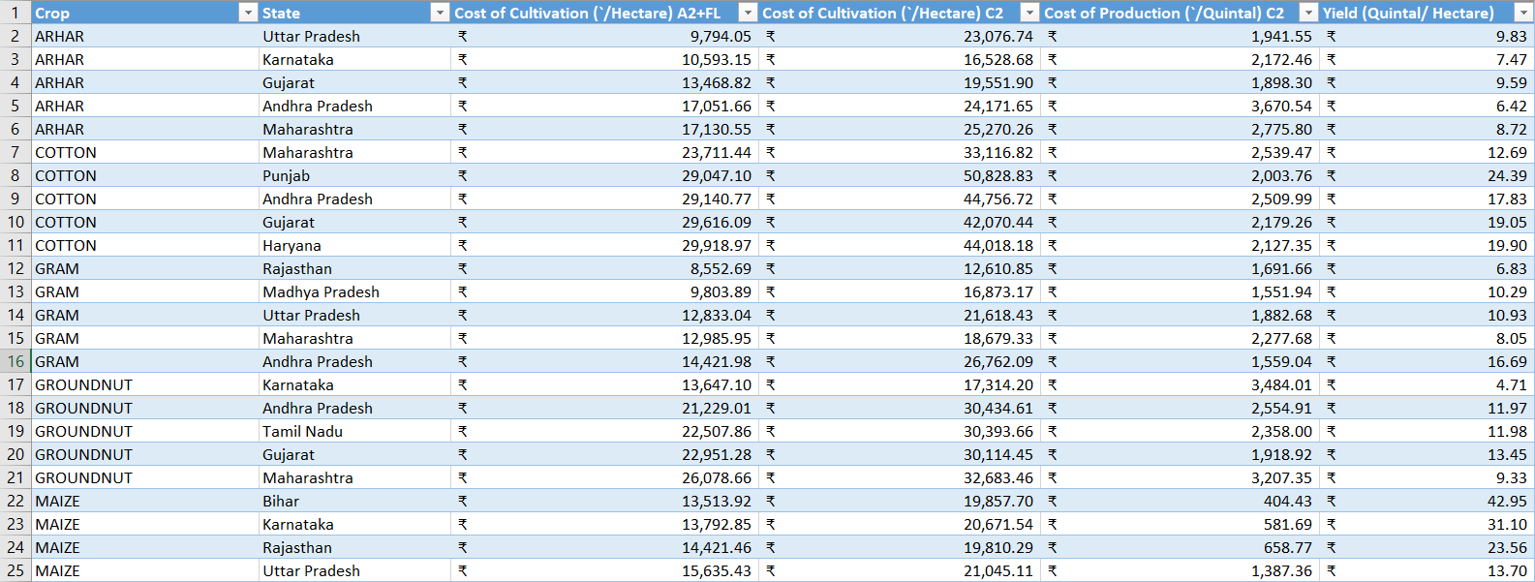
Sample data set:

Slide 7
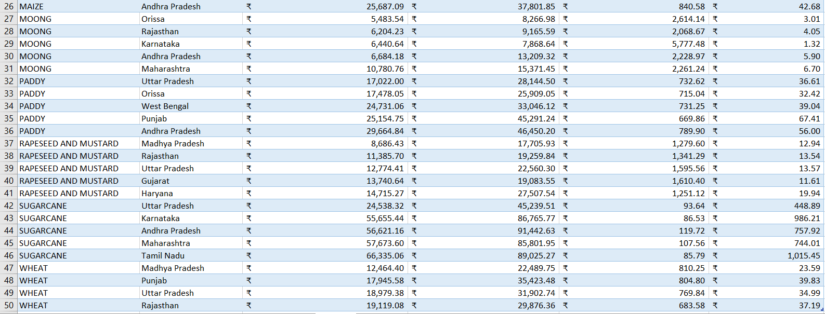

Slide 8
List of features provided:
Particular crop and state statistics
Cost of production and cultivation of the respective crops
Yield’s stats

Slide 9
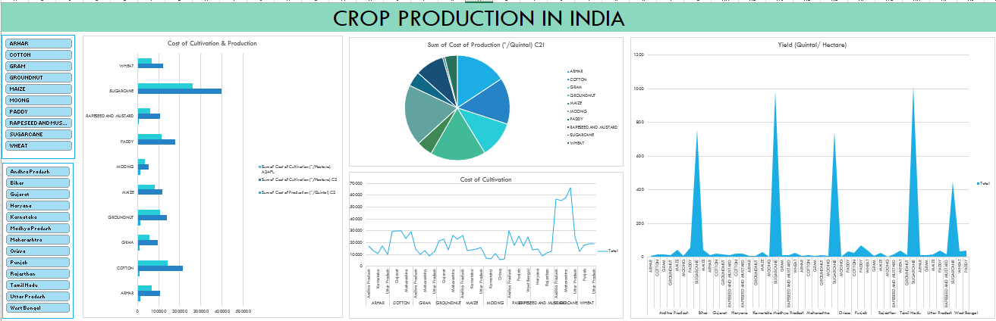
Output

Slide 10
Special features:
Using slicer, we can specify the crop and the state that we want to view.
In this book, we have covered dashboard design best practices and outlined a process to create useful dashboards for any organization.
Conclusion:

Slide 11
Future enhancement:
The yield of crops in the respective state can be founded and in future using this data we can analyse and cultivate the crops and make profits
Website link :
https://www.kaggle.com/srinivas1/agricuture-crops-production-in-india
Reference:

Slide 12


